Slide 1
Wells Fargo: Data Hub Overview
February 1, 2016

Slide 2
LoanSphere Data Hub
2016 LoanSphere Data Hub Business Description
A collection of hardware and software used to ingest, store and link data from Black Knight data sources (such as systems of record and industry data) and third party data sources (such as client and other vendor systems) with client approval to support analytics and workflow to support strategic and operational decision making.
2016 Operational Insight Business Description
A Black Knight technology that enables the creation of small, compact rules that react to loan events. These rules can generate units of insight that drive business processes, that supports operational efficiency and risk mitigation.

Slide 3
Overview
LoanSphere Data Hub is mortgage industry specific
Delivers the richest source of connected client and industry mortgage data
Is not a replacement for data warehousing, rather a mortgage specific solution that compliments existing data strategies
Black Knight manages the linking of hosted client data along with industry data moving the cost and effort of linking and providing actionable data
Using existing technology, automate activities directly into systems of records/workflow application to facilitate efficiency, reduce cost and add value
Data and analytic insights available from Black Knight Advisory Services and client analytic sources to provide enhanced knowledge of customer by understanding and predicting borrower behavior

Slide 4
Data Hub Objectives
Collecting data and other relevant data sources to produce an holistic data view
Turning data into something you use rather than just store
Derive insights to help manage your business, risk, and financial performance
Doing this in a nimble way
Enabling you to ask questions of data and become a “data driven” organization

Slide 5
Architecture/Infrastructure

Slide 6


Hadoop Ecosystem
Data Access
Governance
Integration
Security
Operations
Authentication, Authorization, Audit & Data Protection
Provision, Manage & Monitor
Data Workflow, Lifecycle & Governance
Script
Pig
SQL
HIVE
HCatalog
Java
Cascading
NoSQL
Phoenix
Hbase
Accumulo
Data Management
Stream
Storm
Search
SOLR
In-
Memory
Spark
Others
Engines
Ambari
ZooKeeper
Falcon
WebHDFS
NFS
Flume
Sqoop
Kafka
Storage: HDFS
Resources: YARN
Access: Hive
Pipeline: Falcon
Cluster: Knox
Cluster: Ranger
YARN: Data Operating System
Scheduling
HDFS (Hadoop Distributed File System)
°
°
°
°
°
°
°
°
°
°
°
°
°
°
°
Oozie
°
°
°
°
°
°
°
°
°
°
°
°
°
°
°

Slide 7
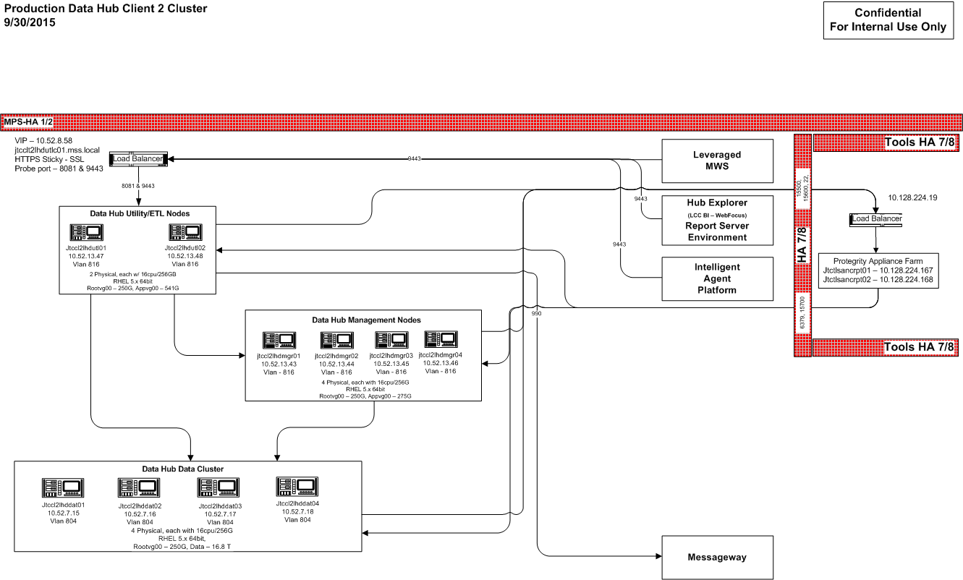
Data Hub Physical Design

Slide 8
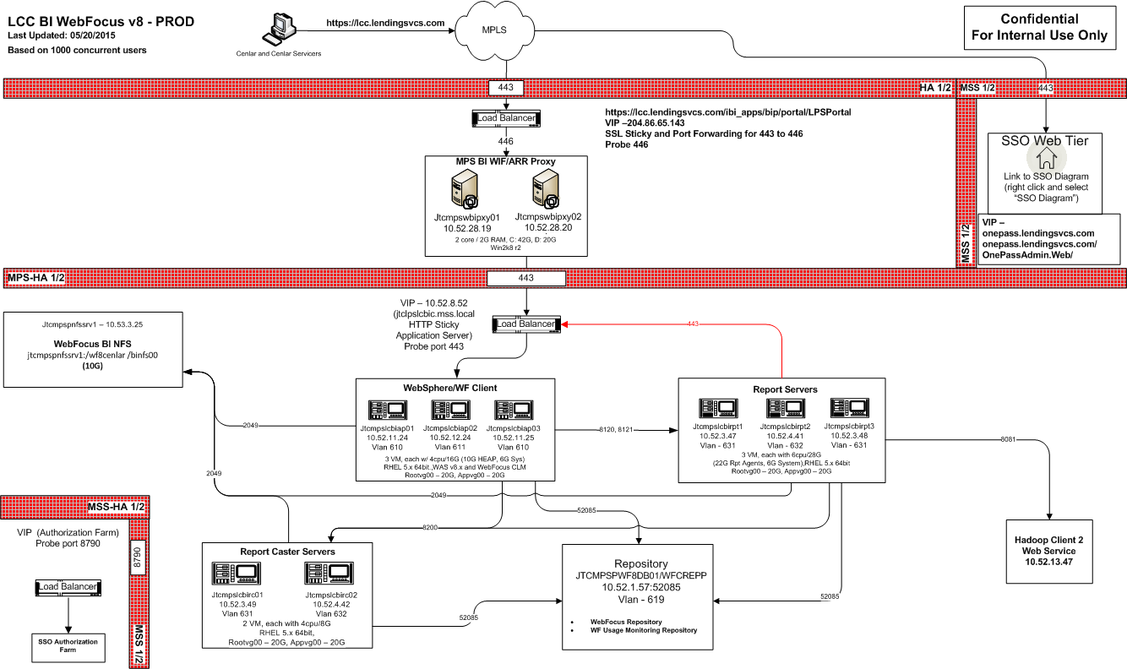
Hub Explorer Physical Design

Slide 9


Data Hub Encryption
Client
Web Focus
Authentication
2 Factor Authentication
Hub Web Services
HTTPS
SSO
Auth
Ranger Admin
Ranger KMS
TDE
API/JDBC
Encryption
Policies
Keys
Zones
HTTPS
Hive/HBase
HDFS
Messageway
Linux O/S
A
B
C
SFTP
A
TDE Encryption Zones
/apps/hive/…
/apps/hbase/…
/ingest-data/bkfs/…
/ingest-data/bkfs/servicing/msp/<clientA>
/ingest-data/bkfs/servicing/msp/<clientB>
/ingest-data/bkfs/default/ecde/<clientA>
EDI
SFTP
Protegrity Security Zones
/bkfs-data/…
BKFS Ingest App
MSP
FC/BK
Read
Write
Client Data Hub

Slide 10
Platform Encryption Summary
Data Hub - combination of native TDE and Protegrity
Protegrity - staging area for source files, prior to being ingested
AES256 bit encryption
Administered by Encryption & Key Management team
Native TDE - protects HDFS, Hive, and HBase
AES256 bit encryption
HDFS directories are protected using TDE Encryption Zones
Key and policy management handled by Ranger Key Management Service (KMS)
Administered by Encryption & Key Management team
Hub Explorer – combination of native WebFocus encryption and Protegrity
WebFocus temp work area, session cache, and Lucene indexes
AES256 bit encryption
Administered by Encryption & Key Management team
Internal WebFocus Client to WebFocus Reporting Server Communications
AES256 bit native WebFocus encryption
Client communication to WebFocus Client
HTTPS

Slide 11
Data and Metadata

Slide 12
Data Catalog - Objectives
Establish a data dictionary describing all data in the Hub, searchable using the Hub Explorer
A common set of metadata that describes each data elements (name, data type, description) with data lineage back to system of record
Define a common semantic layer representing a Unified Data View (i.e. “Single Version of Truth”), based on a MISMO-influenced reference model
The Unified Data View will focus on “standardizing” data elements that exist in multiple source applications, not all data elements in the Hub

Slide 13
Data Catalog - Timeline
1Q16
2Q16
2H16
MSP
Public Records
BK/FC
MSP
Empower
Public Records
BK/FC
MSP
Empower
Public Records
BK/FC
Lending Space
Metadata tagged to every data element; searchable using Hub Explorer
Unified Data View design – scope, lineage, transformations/normalization techniques, etc.
Begin defining common semantic vocabulary for MPS and Public Records
Document lineage to source system
Identify SVOT for data elements that exists in multiple source applications
Begin defining common semantic vocabulary for MPS and Empower
Build Unified Data View for MSP and Empower
Begin defining common semantic vocabulary for Empower and Lending Space

Slide 14
Data Ingest – Flat Files
BKFS Java-based application
Supports delimited and sequential file types
Metadata driven – file schema (layout) is required
Schema versioning supported
Used for internal or external files
Scalable to allow for LOB specific ingest processes

Slide 15
Data Ingest – RDBMS-based Data
Data Sources
RDBMS
Client
Pull Metadata
MySQL
SQL Server
Run Import
Oracle
PostgreSQL
Sqoop
DB2
Launch MapReduce Job
Map Reduce
Map (Sqoop)
Map (Sqoop)
Map (Sqoop)
Pull Data from Database
Hadoop
Hadoop
Hadoop
Write to Hadoop
Hadoop
HDFS
HIVE
HBase

Slide 16
Data Hub Web Services
A way to retrieve data from the Data Hub
Provides access to multiple views of the data
Logical
Aggregated
Key Performance Indicators
Analytics
To be used internally or by the client
Current Use Cases
Supports Active Insights
Supports Operational Insights
Supports Hub Explorer

Slide 17
Data – Retention and Refresh Frequency
Black Knight Application Data (e.g. MSP, Empower, LoanSphere BK/FC)
3 months of daily activity
5 years of month-end snapshots
Unlimited year-end snapshots (Dec. snapshot)
Black Knight Public Records Data
Data Set | Refresh Frequency | Data Retention
Assessment, Deed, SAM | Weekly (Sunday) | Rolling 3 months (12 weeks)
NOD | Weekly (Sunday) | Rolling 3 months (12 weeks)
SIData | Weekly (Sunday) | Rolling 3 months (12 weeks)
Assignments/Releases | Weekly (Sunday) | Rolling 3 months (12 weeks)
xValue (AVM) | Weekly (Sunday) | Rolling 3 months (12 weeks)
MLS | Weekly | Rolling 3 months (12 weeks)
McDash | Monthly | Drop-n-replace (no history)
MLOnline | Weekly | Rolling 3 months (12 weeks)
HPI | Bi weekly | Drop-n-replace (no history)

Slide 18
Commercial Offerings – Feature Comparison
Category | Feature | Tier I | Tier II | Tier III
Environment | Client Dedicated |  | ✓ | ✓
 | Multi-Tenant | ✓
 | Expandable Storage / Compute |  | ✓ | ✓
 | Data Refresh | Daily / Weekly | Daily / Weekly | Daily / Weekly (roadmap intraday where application supported)
Data Menu | Linked Data Sets | ✓ | ✓ | ✓
 | Client Portfolio Data (Servicing, Origination, Default, Invoicing) | ✓ | ✓ | ✓
 | BKFS Enhanced Data (Public Records, MLS, AVM, HPI) | ✓ | ✓ | ✓
 | 3rd party data |  |  | ✓
Retention | 90 Day, 13 Month-Month End, Year End (5 yrs) | ✓ | ✓ | Client Defined
Available 3rd Party Components | Apache Hadoop Stack (client access) |  |  | ✓
Available Black Knight Components | Hub Explorer & Guided Ad Hoc | ✓ | ✓ | ✓
 | Data Hub Web Services | ✓ | ✓ | ✓
 | Active Insight | ✓ | ✓ | ✓
 | Data Extract (Bulk) |  |  | ✓
 | Intelligent Insight Toolkit | BKFS Developed & Published | BKFS Developed & Published | Client Developed / BKFS Developed & Published

Slide 19
Commercial Offerings – Feature Comparison (cont.)
Category | Feature | Tier I | Tier II | Tier III
Optional 3rd Party Supported Components | Hadoop Data Science, Spark, 3rd Party Data Science, Visualization, Machine learning, Algorithms |  |  | ✓
Support | PowerCell (M-F 8am ET – 8pm ET) | ✓ | ✓ | ✓
 | Advisory Services | ✓ | ✓ | ✓
 | Documentation | Catalog / Dictionary | Catalog / Dictionary | Catalog / Dictionary
 | Subject Matter Expertise Resource Access |  |  | ✓
 | Professional Services | ✓ | ✓ | ✓
 | Priority Support |  |  | Direct Level 2 Access, Troubleshooting, Development
Miscellaneous | Data Encryption | Separate Keys | ✓ | ✓
 | Lake to Lake |  | Web Services | Web Services / Bulk Extract
 | 3rd Party Tools (subject to evaluation) |  |  | ✓
 | Virtual Environment Access |  |  | ✓
 | Disaster Recovery | Optional | Optional | Optional

Slide 20
Data Delivery

Slide 21
Client Integration - Architecture

Slide 22
Client Integration - Options
Option | Description | Comments
WebHDFS and Falcon Metadata replication | WebHDFS is a RESTful interface to files stored in Hadoop Falcon is a framework for automating data movement Clients would have access to raw data files via WebHDFS BKFS would need to push file metadata to clients to avoid a client-side ingest. | Requires an HTTP REST API be published publicly Cluster-level authentication/authorization required Ideal when dealing with gigabytes of data; larger data sets can be problematic Metadata delivery is separate from file-level data; potential versioning issues
Kafka | Kafka is the message broker service for Hadoop BKFS Kafka services would send “events” to Client Kafka services, which would take some action “Events“ represent data change records that have occurred Conceptually the same as asynchronous replication | Kafka API versions vary by Hadoop vendor (Hortonworks, Cloudera, MapR); Our Kafka API version might not match the Client’s version Depending on the volume of data that is changing, could results in very heavy message traffic between clusters; bandwidth
Distributed File Copy (DISTCP) | Tool for intra/inter cluster file copying “bulk data copy” | Requires large network bandwidth as all nodes (servers) in the source cluster need to communicate with all nodes in the target cluster API versions vary by Hadoop vendor (Hortonworks, Cloudera, MapR); integration issues if API versions are not in sync Ideal for transferring terabytes of data Memory intensive operation; consumes large amounts of cluster resources Metadata delivery is separate from file-level data; potential versioning issues
BKFS Web Services | BKFS “predefined” web services Aligned to BKFS Data Islands Follows the established pattern of MWS | Ideal for small data requests Customization is supported Does not require special bandwidth or network configurations BKFS cluster is not externally exposed; no firewall rules required Built and supported by BKFS; no compatibility issues

Slide 23
WebHDFS
Client Hub
Data Hub/Lake
Edge Node
Edge Node
REST (https)
Name Node
Name Node
Name Node
Name Node
Name Node
Name Node
WAN
Data Node
Data Node
Data Node
Data Node
Data Node
Data Node
Client Data Center
BKFS Data Center (JTC)
WebHDFS: RESTful interface to Hadoop file store
Requires an HTTP REST API be published publicly
Cluster-level authentication/authorization required
Ideal when dealing with gigabytes of data; larger data sets can be problematic
Metadata delivery is separate from file-level data; potential versioning issues
BKFS could push file metadata to clients to avoid a client-side ingest.
Notes:
WebHDFS is a RESTful interface to files stored in Hadoop
Falcon is a framework for automating data movement
Clients would have access to raw data files via WebHDFS
BKFS would need to push file metadata to clients to avoid a client-side ingest.

Slide 24
WebHDFS/w external Authorization
Client Hub
DMZ
Data Hub/Lake
Edge Node
Edge Node
REST (https)
Kerberos
HTTPS
Name Node
Name Node
Name Node
Name Node
Name Node
Name Node
WAN
Knox
Data Node
Data Node
Data Node
Data Node
Data Node
Data Node
Client Data Center
BKFS Data Center (JTC)
WebHDFS: RESTful interface to Hadoop file store
Requires an HTTP REST API be published publicly
Cluster authorization via Kerberos/Authentication Server
Ideal when dealing with gigabytes of data
Metadata delivery is separate from file-level data; potential versioning issues
BKFS could push file metadata to clients to avoid a client-side ingest.
Notes:
WebHDFS is a RESTful interface to files stored in Hadoop
Falcon is a framework for automating data movement
Clients would have access to raw data files via WebHDFS
BKFS would need to push file metadata to clients to avoid a client-side ingest.

Slide 25
Kafka
Client Hub
Data Hub/Lake
Edge Node
Edge Node
Kafka Producer
Kafka
Mirror Maker
Name Node
Name Node
Consumer
Name Node
Name Node
Name Node
Name Node
WAN
Producer
Data Node
Data Node
Data Node
Data Node
Data Node
Data Node
Client Data Center
BKFS Data Center (JTC)
Kafka is the message broker service for Hadoop
Kafka API versions vary by Hadoop vendor (Hortonworks, Cloudera, MapR); Kafka API version might not match the Client’s version
Depending on the volume of data that is changing, could results in very heavy message traffic between clusters; bandwidth
Conceptually the same as asynchronous replication
Notes:
Kafka is the message broker service for Hadoop
BKFS Kafka services would send “events” to Client Kafka services, which would take some action
“Events“ represent data change records that have occurred
Conceptually the same as asynchronous replication

Slide 26
Distributed Copy (DistCP)
Client Hub
Data Hub/Lake
Edge Node
Edge Node
RPC
Name Node
Name Node
Name Node
Name Node
Name Node
Name Node
WAN
RPC
Data Node
Data Node
Data Node
Data Node
Data Node
Data Node
BKFS Data Center (JTC)
Client Data Center
Requires large network bandwidth as all nodes (servers) in the source cluster need to communicate with all nodes in the target cluster
API versions vary by Hadoop vendor (Hortonworks, Cloudera, MapR); integration issues if API versions are not in sync
Ideal for transferring terabytes of data
Memory intensive operation; consumes large amounts of cluster resources
Metadata delivery is separate from file-level data; potential versioning issues
Notes:
Tool for intra/inter cluster file copying
“bulk data copy”

Slide 27
Web Services
Client Hub
DMZ
Data Hub/Lake
Hub Web Services
Edge Node
Edge Node
REST (https)
Application
HTTPS
Name Node
Name Node
Application
Name Node
Name Node
Name Node
Name Node
Data Node
Data Node
WAN
Data Node
Data Node
Data Node
Data Node
Client Data Center
BKFS Data Center (JTC)
Ideal for small data requests
Customization is supported
Does not require special bandwidth or network configurations
BKFS cluster is not externally exposed; no firewall rules required
Built and supported by BKFS; no compatibility issues

Slide 28
Operational Insights

Slide 29
Overview
Integration
Objective: Reduce point to point integrations using existing Black Knight software (like MWS and RealEC) to improve velocity and reduce support overhead
Operational Insights
Compact units of code that react to data events, producing insights (populate dashboards and drilldowns) and workflow (system and human)

Slide 30
Interaction with Operational Applications
1
2
BK Integration
Systems of Record &/or Workflow
Client Data Hub 1
Client Data Hub 3
Overview
Client data persisted in physically separated Data Hubs
Jobs execute on Hub environment to identify changes in data over time
Kafka based services publish data to Black Knight Integration platform
Agent Platform subscribes to Kafka events and acts upon data invoking Agents from the Agent catalog
Agent publishes results of evaluation to Black Knight Integration
Workflow (system to system and human in the loop workflow) published to workflow applications
6
Empower
3
Client Data Hub 2
Client Data Hub [n]
Lending Space
Loan-Sphere BK/FC
Agent Platform
5
Others
Agent Config
Develop-ment
API
4

Slide 31
Insight Patterns
Enables exception identification and automates units of work
Monitoring for regulatory, GSE, internal procedure requirements and identifying loans falling outside thresholds
Identifying loans that have data that represent illogical conditions or potential data out of synch conditions
Determining when a specific event occurred or didn't occur as expected by monitoring change in state or status of a loan
Automation Insight
Compliance Insight
Data Quality Insight
Event Insight
Specifies request/receive instructions as well as data enrichment or orchestration within response
Analyzes trends to identify patterns that could indicate specific outcomes
Continuous monitoring of all loans/select loans to identify when something specific occurs through compares across datasets
Integration Insight
Predictive Insight
Surveillance Insight

Slide 32
Insight Scenarios
SCRA
Lien Perfection
Book and Page
CFPB Timeline
Bankruptcy Payment Change Notice
FC/LM Status
BK Stops
Late Payment
No Notice
No Contact
Automation Insight
Compliance Insight
Data Quality Insight
Event Insight
Property Profile
It’s Listed
AVM
System-to-system
FHA First Legal Action
Notice Timeline Trend
D&A Predictive
Payoff Conveyance
Lead Generation
SCRA
Integration Insight
Predictive Insight
Surveillance Insight

Slide 33
Insight Scenarios Detail
Lien Perfection
Problem - After the loan closes, the originator has to manually verify that ALL liens have been released by going to public records and pinging for open liens and then clearing all open liens with previous servicers
Solution - After the loan closes, matches property to public records to verify all existing liens have been extinguished
CFPB Timeline
Problem – CFPB guidelines require lenders to send notifications to borrowers within a specified timeframe
Solution - Identify loans that are within a specific number of days prior to the required notification day where the notification has not been sent.
BK Stops
Problem – When a loan is in bankruptcy servicers are not allowed to send certain notices , charge late charges or report to the credit bureau. These settings can inadvertently be turned off causing the servicer to be out of compliance
Solution - Identify loans that are in BK but do not have the correct settings to stop notices, late charges, and credit bureau reporting
No Contact
Problem – Servicers are required to attempt to contact customers who are delinquent within a certain timeframe. Based on dialer prioritization rules and volume of loans, borrowers are not getting contacted within the time required
Solution - Identify loans that should have received a call but have not within specific timeframes
Automation Insight
Compliance Insight
Data Quality Insight
Event Insight
Property Profile
Problem – Users leave BKFS applications to order property reports etc…
Solution - Integrate the property profile report and other reports to allow originators and servicers to order D&A reports directly from BKFS applications (Empower/Director). The data from the report can be viewed directly in that application and data from the report can be updated within the application.
Notice Timeline Trend
Problem: CFPB requires notifications be sent within a specific timeframe
Solution: Monitor loan servicing portfolio for upcoming compliance milestones to identify trends of increasing notification timelines which allows operations to address the potential problem before it has a negative impact on customer experience or potentially becomes a compliance issue
Lead Generation
Problem – Lenders need ability to generate leads from within their portfolios when a property is being sold
Solution – Monitor a servicer’s portfolio to identify when a property has been listed and generate a lead to SalesEdge or Empower. Monitoring for payoff quote within Servicing and prepayment propensity analytics can also generate leads.
Integration Insight
Predictive Insight
Surveillance Insight

